Slide 1
How to write a good CV
Prof. Krishna Misra
IIIT-Allahabad
Dated October 6 , 2021

Slide 2
How to write a good CV
Example CV
Research your target roles
Create an effective structure and format
Write a powerful CV profile
Detail your work experience in well structured roles
List your education and qualifications
Interests and hobbies are optional

Slide 3
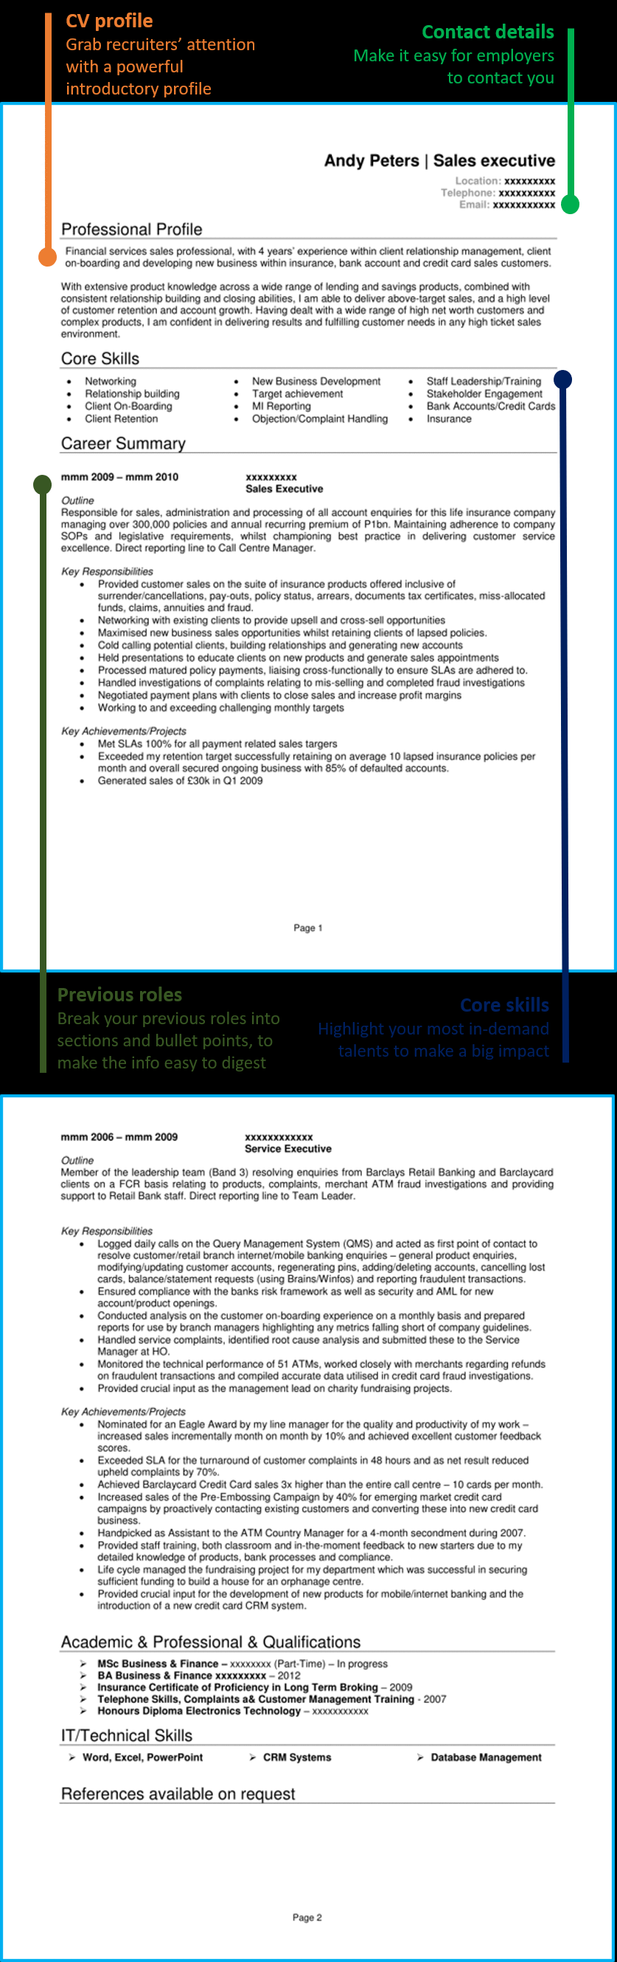

Slide 4
An artistically designed CV

Slide 5
A brief to the point CV

Slide 6
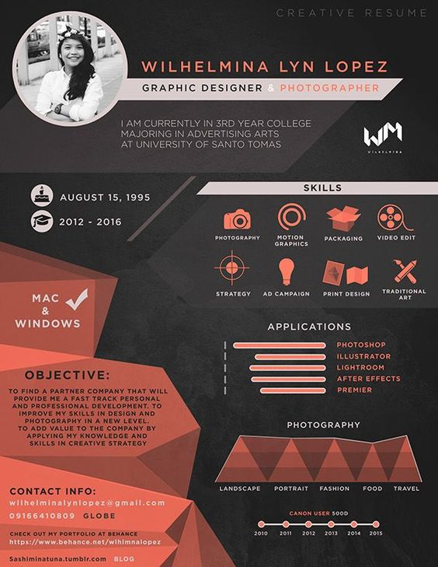

Slide 7
Before you start writing your CV
Solid preparation is the key to success in most areas of life and CV writing is no different.
Your CV is one of the most important documents you will ever create and it will shape the future of your career, so it pays to put in some prep time to get yourself on the right track.
Before you start crafting your CV, you will need to understand a few things if you want to be successful;
What your CV is supposed to achieve
What employers want to see in your CV
Who will be reading your CV (Recruiters & Hiring Managers)

Slide 8
What is your CV actually supposed to achieve?
A good CV is supposed to get you lots of job interviews for the jobs you want – it’s that simple
That’s obviously easier said than done, but try to remember that point throughout your CV writing process.
The way which a CV wins job interviews for you, is by quickly demonstrating to employers that you are the right person for their job.
In order to achieve this, you need to understand what employers want to see and how they want to see it
What do employers want to see in your CV?
99% of candidates ruin their chances of job hunt success before they have even typed one word on their CV.

Slide 9
Why ruin your chances?
Because they don’t take the time to find out what their target employers are looking for.
They simply write their CV based on the qualities that they think are important.
If you don’t research the needs of the companies that you are hoping to work for, then you don’t actually know what you should be including in your CV.
You will be using guess work as the foundation of your CV, which will set you up to fail in your job search.
The very first thing you need to do, is find out what your target employers are looking for in candidates' CVs, so that you can then fill your CV with content that matches their needs – and therefore impress them.
You can actually find out what these needs are quite easily with some simple online research – looking at relevant job adverts is a good place to start.
Hit the job websites and run a search for the main type of job you are interested in.

Slide 10
How to write a good CV (Curriculum Vitae))
Identify the right personal details to include.
Learn what to add and what to leave out, such as whether to include your marital status or nickname.
Add a personal statement.
Find out what one is and how it can be used to focus a potential employer’s attention on your best attributes.
Know what to include in the skill section.
Discover how to bring your skills to the fore and make sure you understand the difference between transferable, job-related and adaptive skills.

Slide 11
Writing a good CV
Mention former jobs. Brush up on the best ways to present former or current employment in a way that shows you in the best light.
Don’t forget your qualifications. Learn what to include, how to select relevant qualifications for a particular CV and why not listing everything exhaustively is crucial.
Tailor it to the application. Gain skills with writing a CV that is adapted to an individual employer or a particular sector of industry to get the best results.
Keep it up to date . Find out the best ways of keeping your CV up to date so that it is ready to go at a moment’s notice.

Slide 12
What to say about yourself ?
When you are being speculative, it is best to keep your options open, so don't focus on one particular skill or qualification.
Showing that you are an all-rounder can be much more effective than being a specialist.
Key information, such as stating that you are a second-jobber looking for career progress, can be helpful.
These details are a chance to say that you are ambitious – something that most prospective employers want to hear.

